Slide 1
HUMAN RESOURCE PROJECT
Mentor:-
Abdul Rahman
Group 4
Robin Roy
Vrushali Shinde
Meera Pal
Abhinandan kumar
Devesh Gaonkar

Slide 2


What Do You Mean By HR ?
HR Analytics is the process of collecting and analyzing Human Resource (HR) data in order to improve an organization’s workforce performance. The process can also be referred to as talent analytics, people analytics, or even workforce analytics.
This method of data analysis takes data that is routinely collected by HR and correlates it to HR and organizational objectives. Doing so provides measured evidence of how HR initiatives are contributing to the organization’s goals and strategies.

Slide 3
What is the role of HR Analytics in organization ?
Identify underlying causes and trends of employee attrition by analyzing past data.
Collect data on HR productivity and engagement.
Using data analysis to understand new employee behavior.
1
2
3
Identify insights from the data and report them to management
Understanding patterns behind important concerns like low employee performance through the correlation of various types of data.
Developing predictive models to understand employee behavior and performance.
4
5
6

Slide 4
Benefits of HR Analytics
01
02
03
Decreased Attrition Levels
Achieves Employee Trust
Healthy Work Culture
With HR analytics, you can identify your organization’s hidden patterns and trends by using employee-related data to discover what drives employee retention. HR analysts also offer suggestions for decreasing attrition rates based on various data points.
The HR management can boost employee satisfaction based on the data and analysis. In addition to helping formulate effective HR policies, this creates a sense of belonging in employees and makes them start trusting their employers.
This data analysis helps to create a healthy work environment for employees and prevents workplace misconduct.

Slide 5
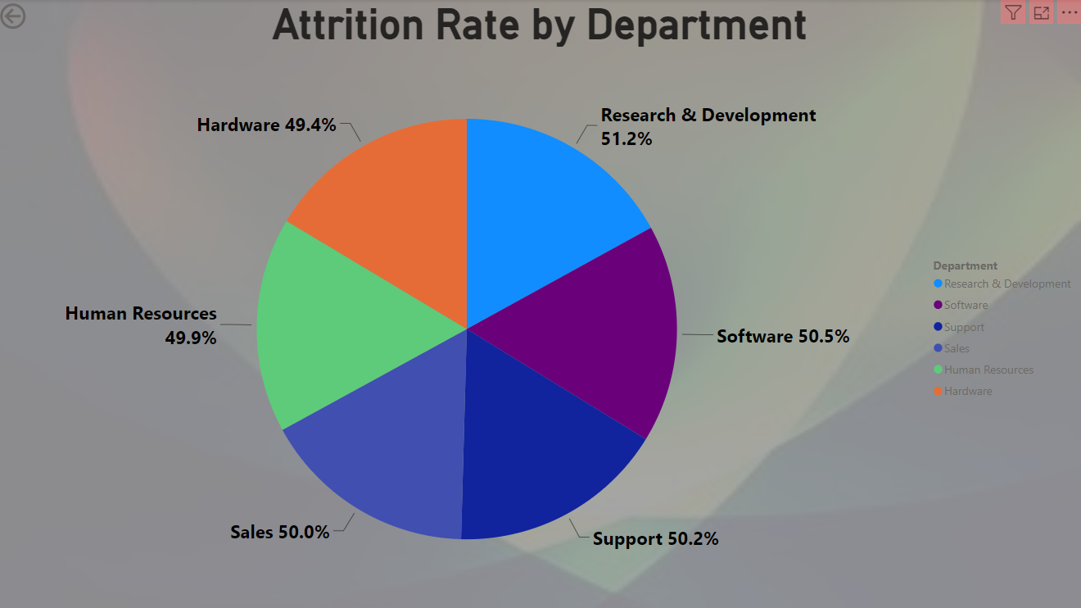
KPI 1 Average Attrition Rate For All Department
This KPI is to find out the relationship between each department and its attrition rate and here attrition rate is highest for Research & Development Department whereas lowest is for Hardware Department.

Slide 6
Insight from KPI 1
We can clearly say that attrition rate of employees for every department is almost 50% which indicates that attrition rate of employees does not depends on departments. So, irrespective of the department almost 50% of employees are leaving the company.
From this visualization we can concluded that we must make strong strategies to minimize attrition rate and improve our company’s Employee retention so that we can balance the company’s growth and right talent.

Slide 7
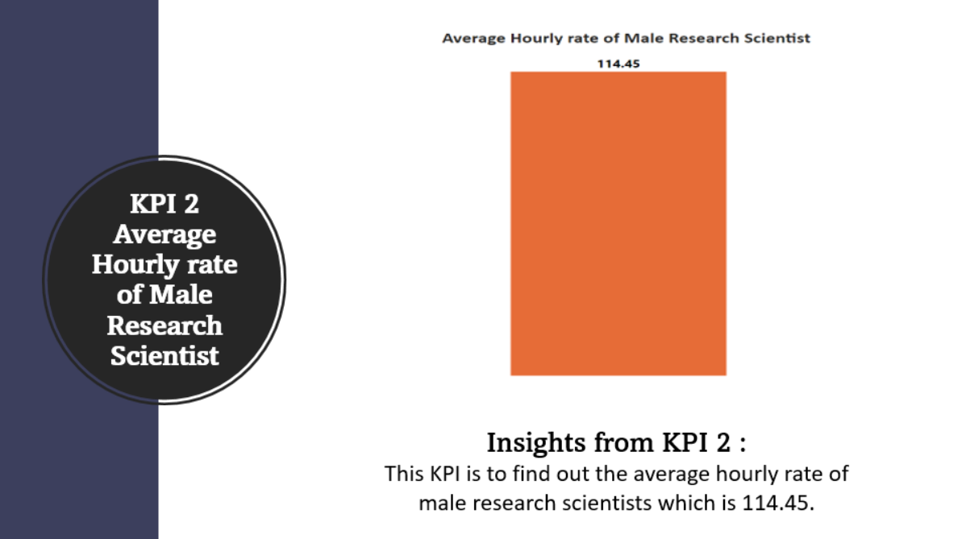

Slide 8
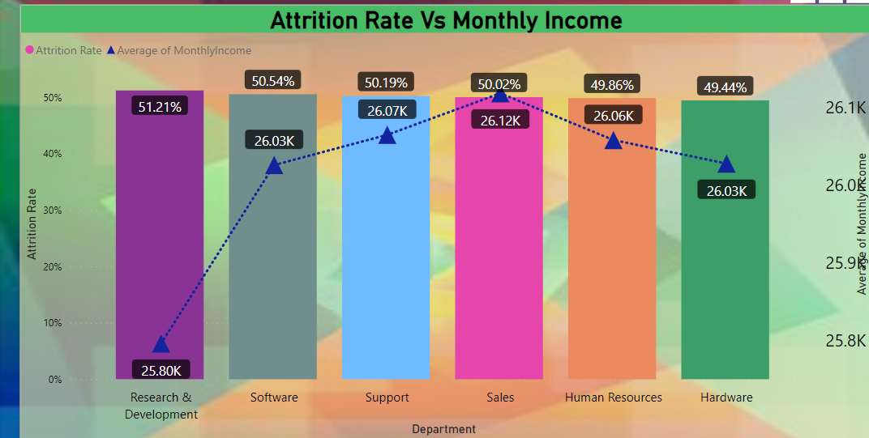
KPI 3 Attrition Rate Vs Monthly Income Stats
This KPI is about to fetch data for attrition rate vs monthly income stats.
Insight :-
Based on our analysis and visualization, it is evident that the Hardware Department has the lowest attrition rate of 49.44%, with an average monthly income of Rs. 26,091.20. On the other hand, the Research and Development Department has the highest attrition rate of 51.21%, with an average monthly income of Rs. 26,007.08

Slide 9
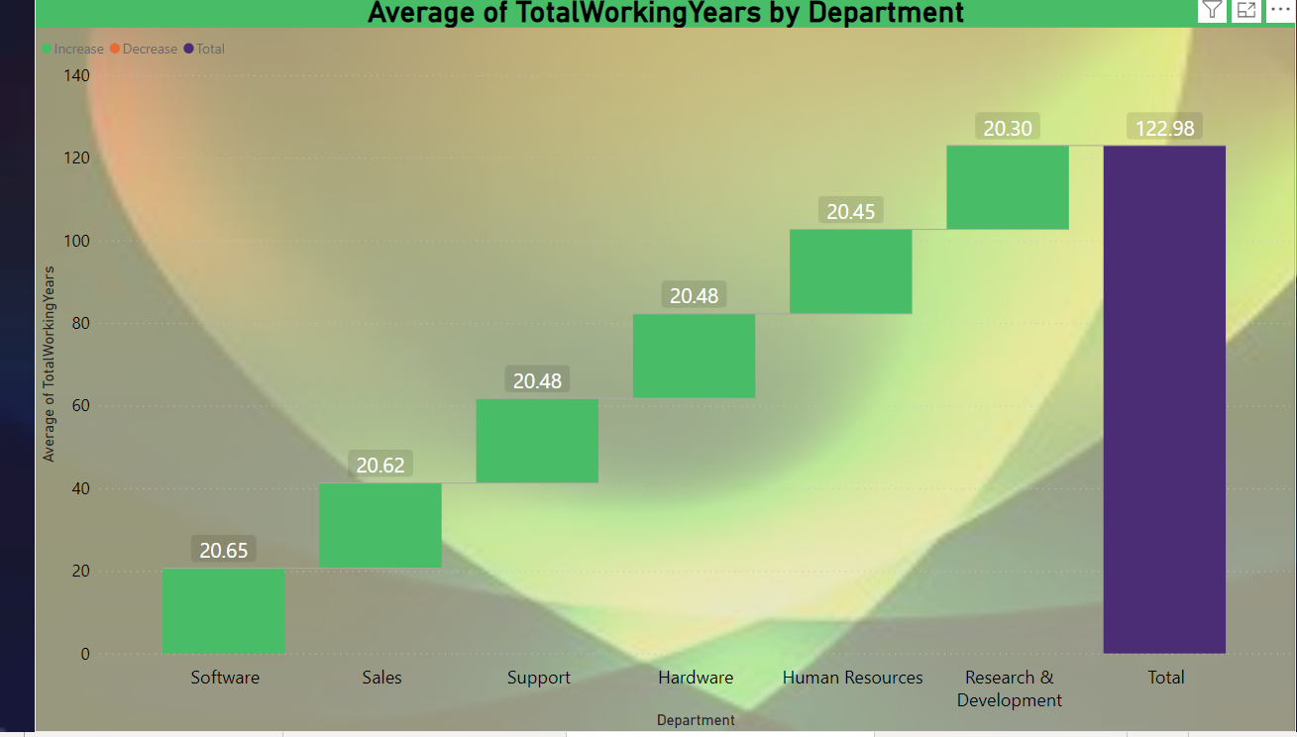
KPI 4 Average Working Years For Each Department
This KPI shows Average Working Years For Each Department.
Insight :-
From this we can see the average working years in software department is high as compared to the rest of the department and lowest is for research and Development Department.
From this we analyze and conclude that average working years is approximately 20 years for all Department.

Slide 10
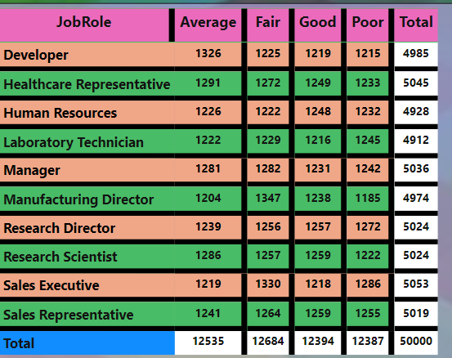
KPI 5.Job Role VS Work life Balance
This KPI is about Job Role VS Work life Balance for Total Employee.
Insight :-
Developer and Human Resource has poor work life balance
Laboratory Technician and Manufacturing Directors has average work life balance.
Research Scientist and Research Director has fair work life balance
Manager and Sales Representative and Sales Executive has good work life balance

Slide 11
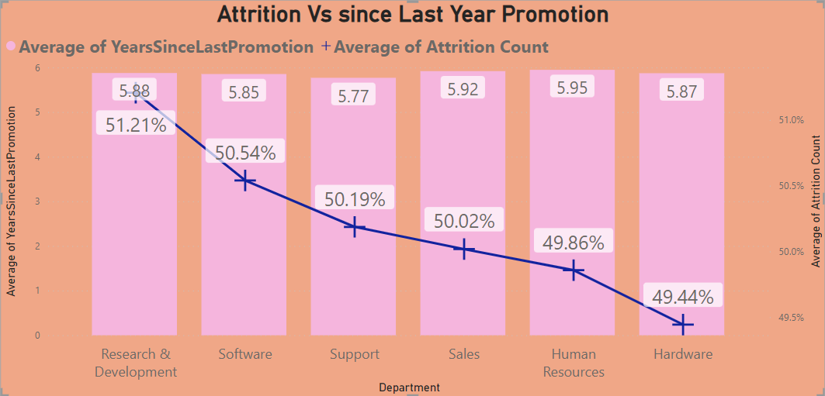
KPI 6. Attrition Rate VS Last Year Promotion
This KPI shows attrition rate vs since last year promotion.
Insight :-
From KPI 6 we can conclude that attrition rate for Research and Development is compared to other Department .
Human Resource and Sales Representative of avg since last year promotion is higher as compared to other department

Slide 12
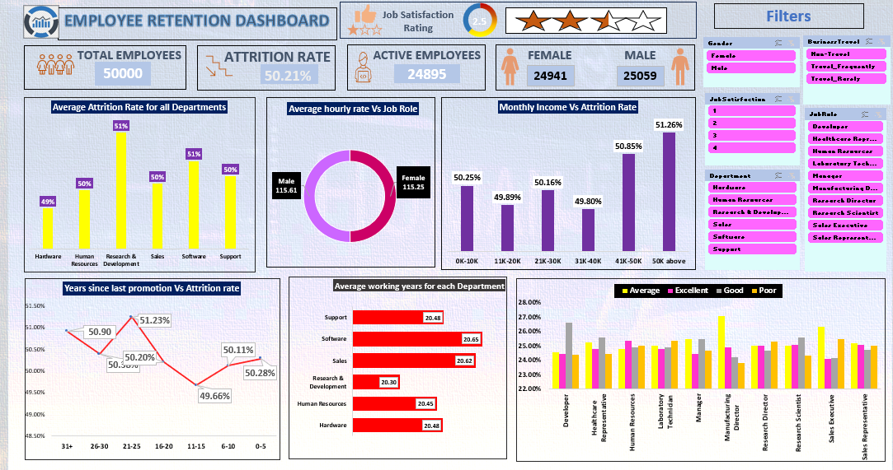
Excel Dashboard

Slide 13
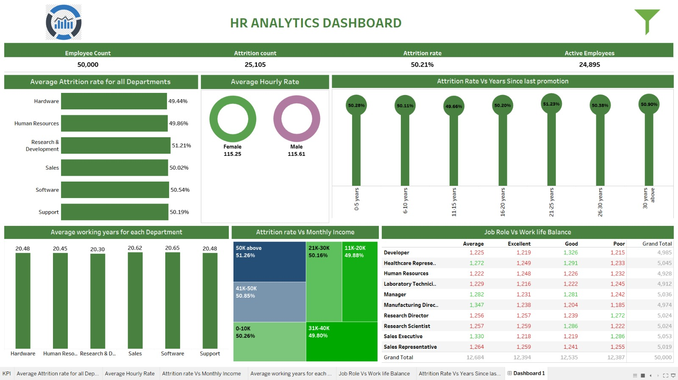
Tableau Dashboard

Slide 14
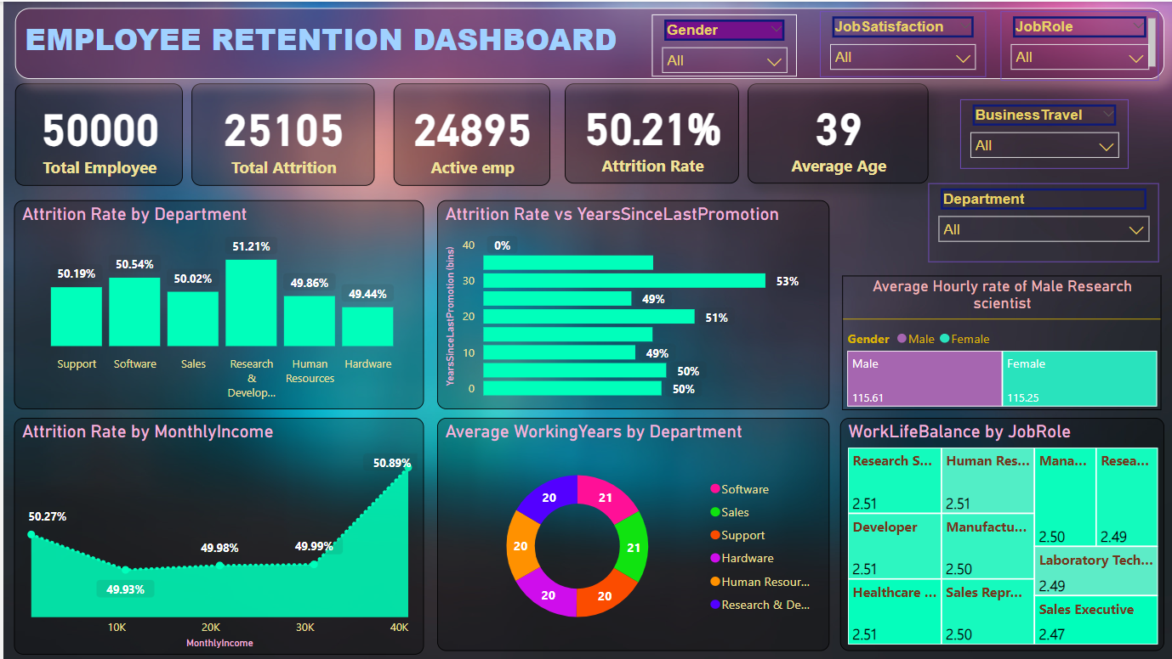

Power BI Dashboard
Simplified View
GUI Focused

Slide 15
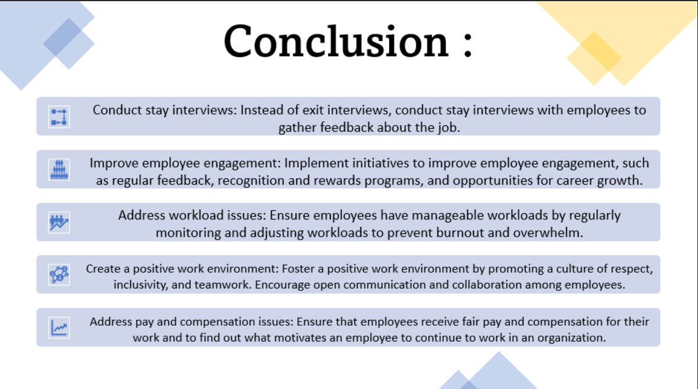

Slide 16

THANK YOU

